Slide 1


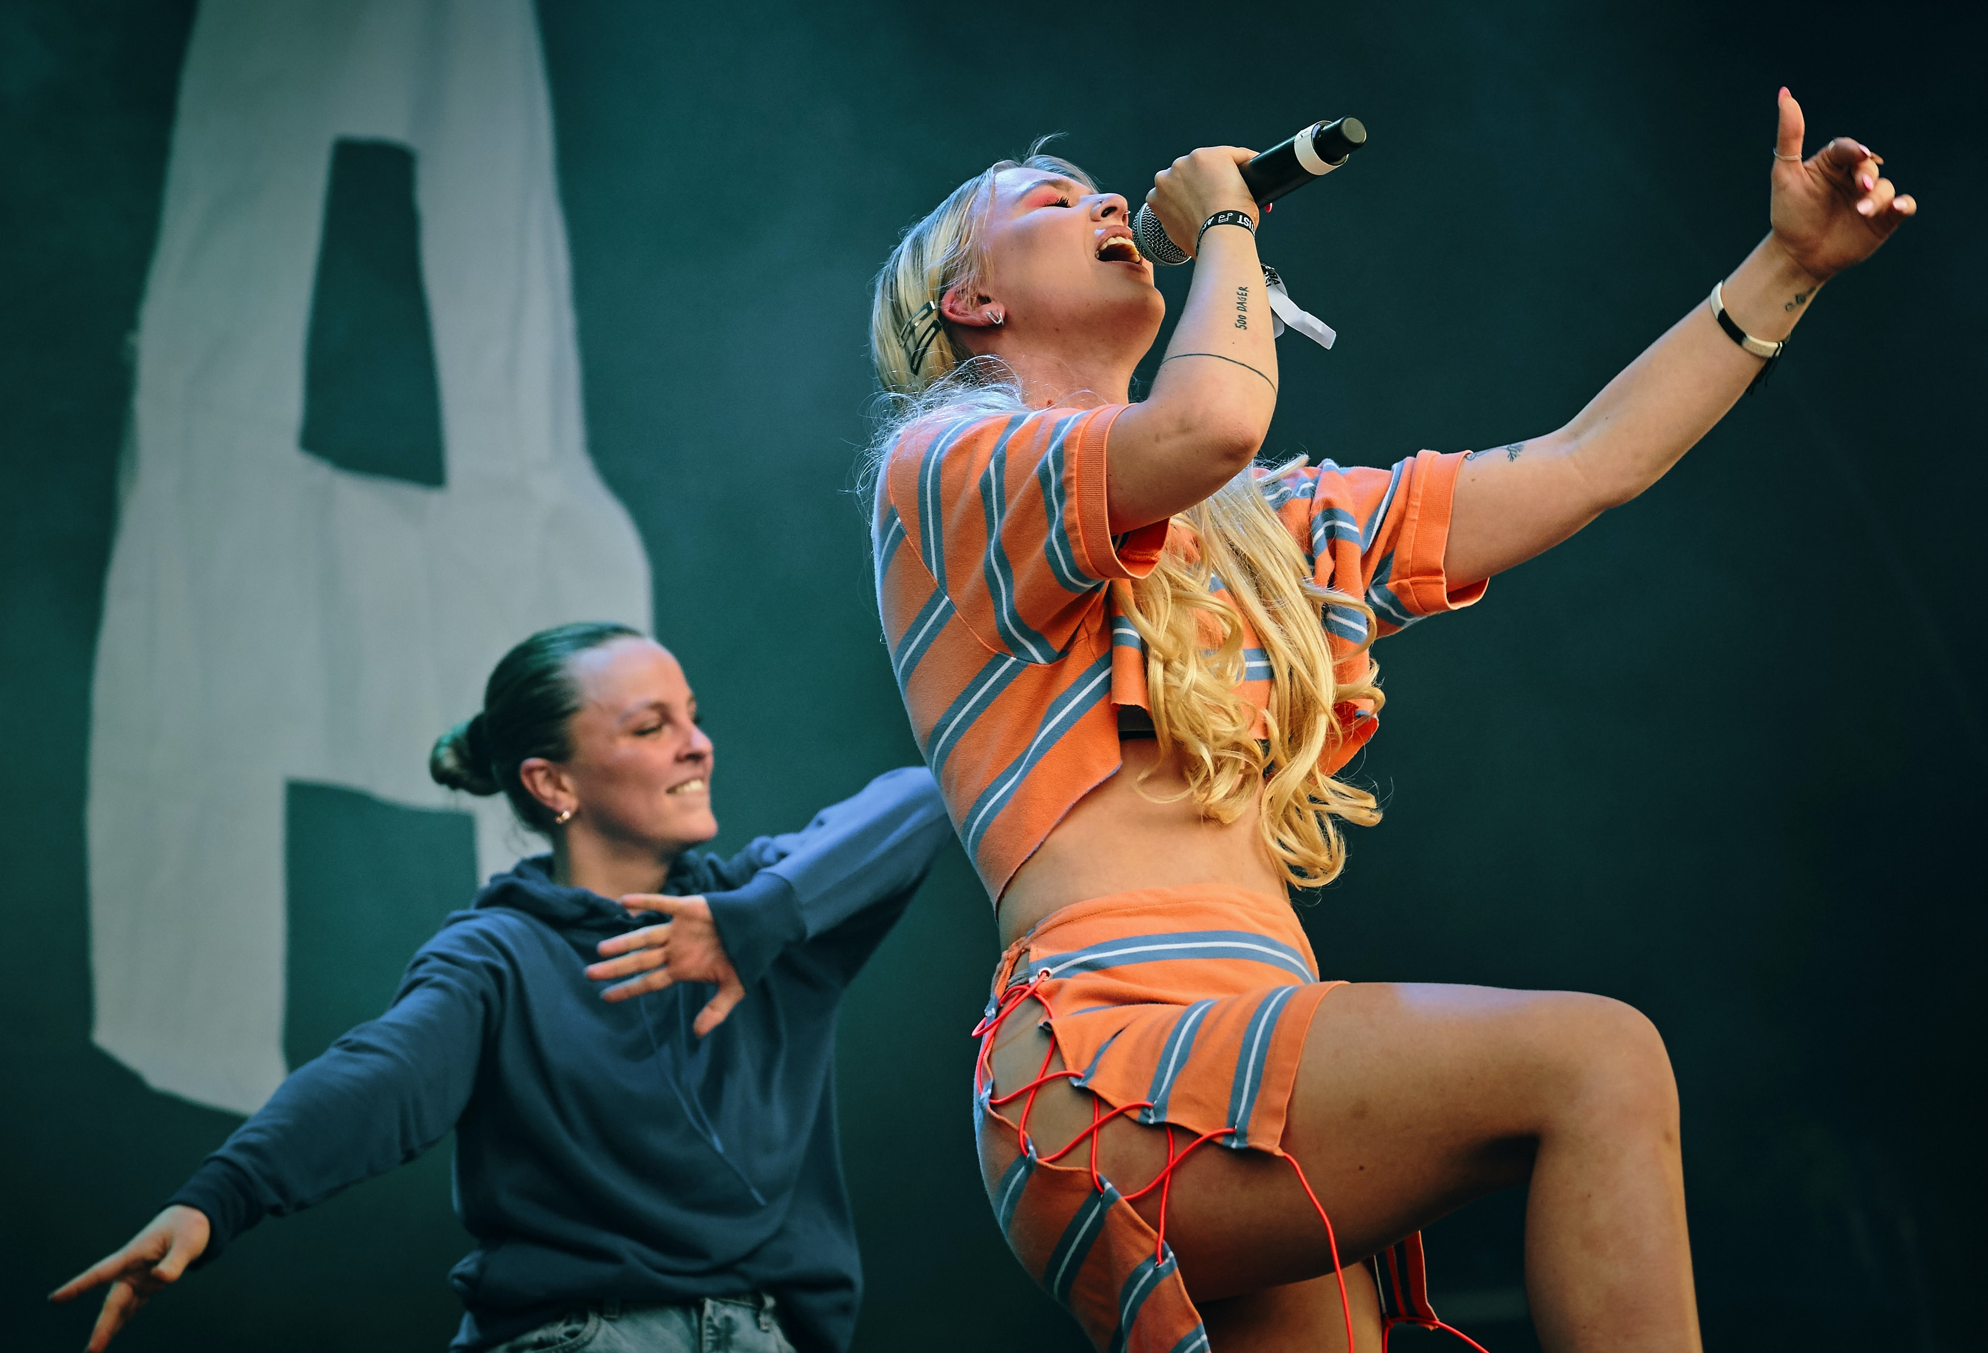
YOUTUBE
Data Analysis
Submitted by:
Suraj Vishwakarma (12115712)
Submitted to:
GIRISH KUMAR
Notes:
Creadit picture : Unsplash Photo by Chris Yang
Link : https://unsplash.com/photos/1BtAeOohu1A Photo by Vidar Nordli-Mathisen
Link : https://unsplash.com/photos/xqMM3KoR7oI

Slide 2





What is YouTube?
YouTube Data
YouTube is a free video sharing website that makes it easy to watch online videos. You can even create and upload your own videos to share with others. Originally created in 2005, YouTube is now one of the most popular sites on the Web, with visitors watching around 6 billion hours of video every month.
Home
YouTube API
Objective
Libraries
Insights
Trending
Help
MrWhoseTheBoss
TechnicalGuruji
Austin Evans
LinusTechTips
End Note
Notes:
Creadit picture : Photo by Anthony Intraversato on Unsplash Link : https://unsplash.com/photos/vYRAP3yMa3I

Slide 3


YouTube Data
Home
What is YouTube
API?
YouTube API
Objective
Libraries
The API provides the ability to retrieve feeds related to videos, users, and playlists. It also provides the ability to manipulate these feeds, such as creating new playlists, adding videos as favourites, and sending messages. The API is also able to upload videos.
Insights
Trending
EDIT PROFILE
SHARE
Help
End Note
Notes:
Creadit picture : Photo by Ethan Haddox on Unsplash Link : https://unsplash.com/photos/jvUZkoh4Hhw

Slide 4


YouTube Data
Home
YouTube API
Objective
Libraries
Insights
Trending
16 November 2022
View
Help
Project Objective
12.115.712
End Note
It’s a YouTube data analysis project with the help of YouTube API and python to extract the insights from the famous tech channels and compare their channel statistics to get the idea of their growth, most-watched videos, etc.
776
10

Slide 5

Libraries
YouTube Data
Home
YouTube API
Objective
Libraries
Insights
Pandas
Seaborn
Trending
Pandas is a predominantly used python data analysis library. It provides many functions and methods to expedite the data analysis process. What makes pandas so common is its functionality, flexibility, and simple syntax.
Seaborn is a library for making statistical graphics in Python. It builds on top of matplotlib and integrates closely with pandas data structures. Seaborn helps you explore and understand your data.
Help
End Note

Slide 6
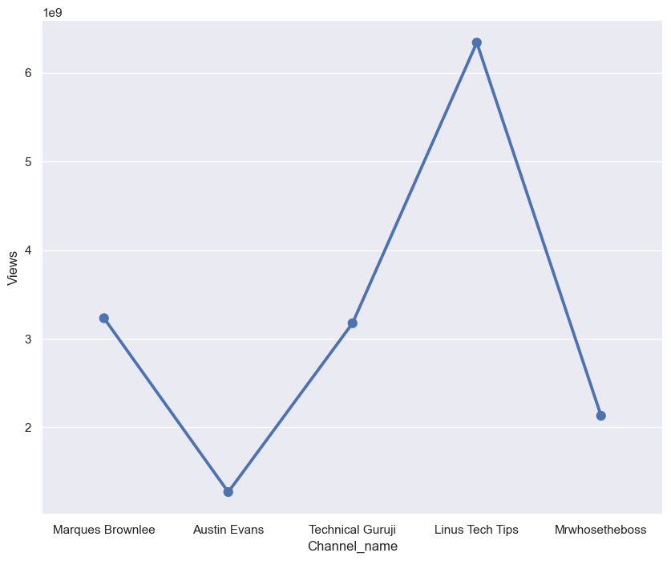
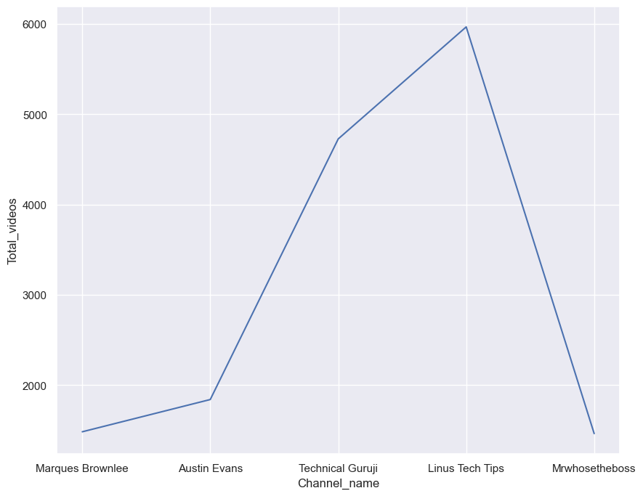
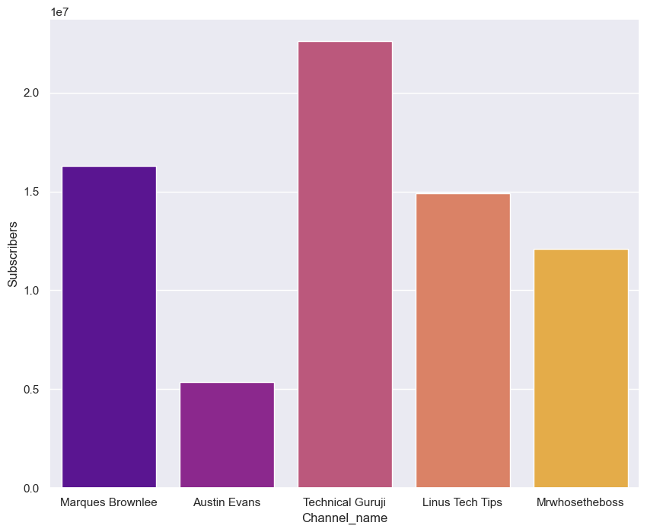
YouTube Data
Home
YouTube API
Objective
Libraries
Insights
Most Subscribed
TechnicalGuruji
Trending
Help
Most Viewed
LinusTechTips
End Note
No. of Videos
LinusTechTips
Notes:
Creadit picture :
Photo by Jordan on Unsplash Link : https://unsplash.com/photos/evtWtv0i-6E

Slide 7
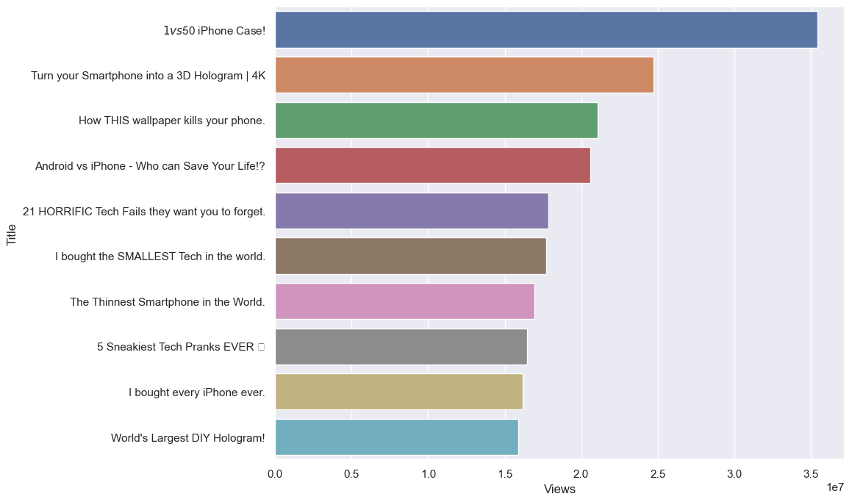
Top 10 Videos of MrWhoseTheBoss
YouTube Data
Home
YouTube API
Objective
Libraries
Insights
Trending
Help
End Note

Slide 8
Help
YouTube Data
Search help
Home
Popular help resources
YouTube API
Objective
https://developers.google.com/youtube/v3/docs
Libraries
Insights
https://console.cloud.google.com/apis/dashboard?project=yt-analysisproject-364212
Trending
Help
https://commentpicker.com/youtube-channel-id.php
End Note
https://jsonformatter.curiousconcept.com/#

Slide 9
YouTube Data
Home
End Note
YouTube API
In this project, I had learned at how to analyze YouTube data and use of API available on the web. We can do this with the Twitter data also. Facebook doesn’t allow access to universal data for privacy reasons. In this project, I had looked at mining YouTube data specifically.
There is a link below of the complete analysis if you want to check or add more to this analysis.
Objective
Libraries
Insights
Trending
To Visit the Project
Click Here
Help
End Note

Slide 10
THANK
YOU

